Slide 1





Stacked Data Matrices Open Issues
Federico Vegetti
University of Turin

Slide 2
Studying vote choice in a comparative perspective
The approach discussed in this workshop is considered to be the state of the art in comparative research on voting behavior
Many published studies are based on different versions of this approach
However, there are 2 problematic aspects to it:
The specific statistical model of choice
How to integrate respondent-level variables into the picture (the “y-hats issue”)

Slide 3
Starting point: multiple choice models
Born in economics as a way to model consumers’ behavior
Based on “random utility theory”
Every option can bring a potential utility to individuals
(utility: the degree of satisfaction that a person expects from choosing a certain option)
Utility varies across individuals: different people have different utilities for different options
Individuals are utility maximizers: they will choose the alternative that yields the highest utility
What produces the utility?
The characteristics of the “chooser” (the citizens)
The characteristics of the “choice options” (the parties)

Slide 4
Multinomial logit model (MLM)
The values of the predictors are constant across choice options
A religious voter is always religious, whenever she's choosing between CDU and SPD or between the Left and the Greens
The parameters vary across choice options
The fact of being religious has different importance whether the choice is between CDU and SPD or whether it's between the Left and the Greens
The observed effects are specific
How to compare the effect of being religious on the vote between countries that have different parties?

Slide 5
Conditional logit model (CLM)
The values of the predictors vary across choice options
Parties have different views over the extent to which European countries should be politically integrated
The parameters are constant across choice options
We look at the effect of parties’ position on European integration on their appeal to the voters
The observed effects are generic
We can tell whether European integration is more important in Germany or in Italy

Slide 6
Comparisons
Other relevant considerations multiple choice models
In MLMs, all the alternatives are compared with a baseline alternative
E.g. we compare the effect of being religious on the choice between CDU and SPD, CDU and the Left, CDU and the Greens, etc.
The models are equivalent, coefficients will vary depending on the comparison, but the predictions will be always the same
In CLMs, the alternatives are compared against each other
There is no constant term – CLMs have no intercept

Slide 7
Comparative voting behavior
Now our goal is to study vote choice, but comparatively
This implies that there are different sets of alternatives in different contexts
Hence, we can not use MLM, as the parameters are alternative specific
Open issues:
Can we use CLM?
How to incorporate the individual characteristics, which do not change between alternatives?

Slide 8
The statistical model of choice
Can we use conditional logit to study vote choice in a comparative perspective?
There exist generalizations of the CLM where the coefficients are random: they vary between contexts
However, they are used with panel data: the choice options and the respondents are the same
It is not clear whether it is possible to model simultaneously many instances with different alternatives
Even though we can use random effects to account for the different alternatives, the problem remains when we have different numbers of parties in different elections

Slide 9
The statistical model of choice /2
An alternative is to use a multilevel binary logit model (MBL) on the stacked data matrix (as we do)
In its most basic form this is equivalent of a fixed-effects (FE) model with observations nested within individuals
Some open questions
Is it wrong?
Does it produce biased results?

Slide 10
Using MBL with multiple choice data
From the point of view of the data generating process there is one problem
For every alternative, we are modeling the choice [chosen vs. not chosen] instead of explicitly modeling the choice of one option against the other options
In other words we can have only a single chosen option (1) per individual (all the others will be 0)
This implies that
The model is neither a “real” FE model, nor a CLM
The individual-level intercept is useless, as it won’t vary between individuals

Slide 11
Using MBL with multiple choice data /2
Point 1 is not such a big deal (there can be FE models where in each group there is only one 1 and many 0s)
Point 2 often posits a problem of convergence, since in MBL models the variance of the intercepts is estimated
As with many other things, it all boils down to the question whether this type of model produces biased estimates

Slide 12
MBL vs CLM
Example
I took all EES data from 1989 to 2014 (harmonized)
I wanted to explain vote choice using left-right distance and party ID
I ran a CLM and a MBL for each election
Let us compare the coefficients

Slide 13
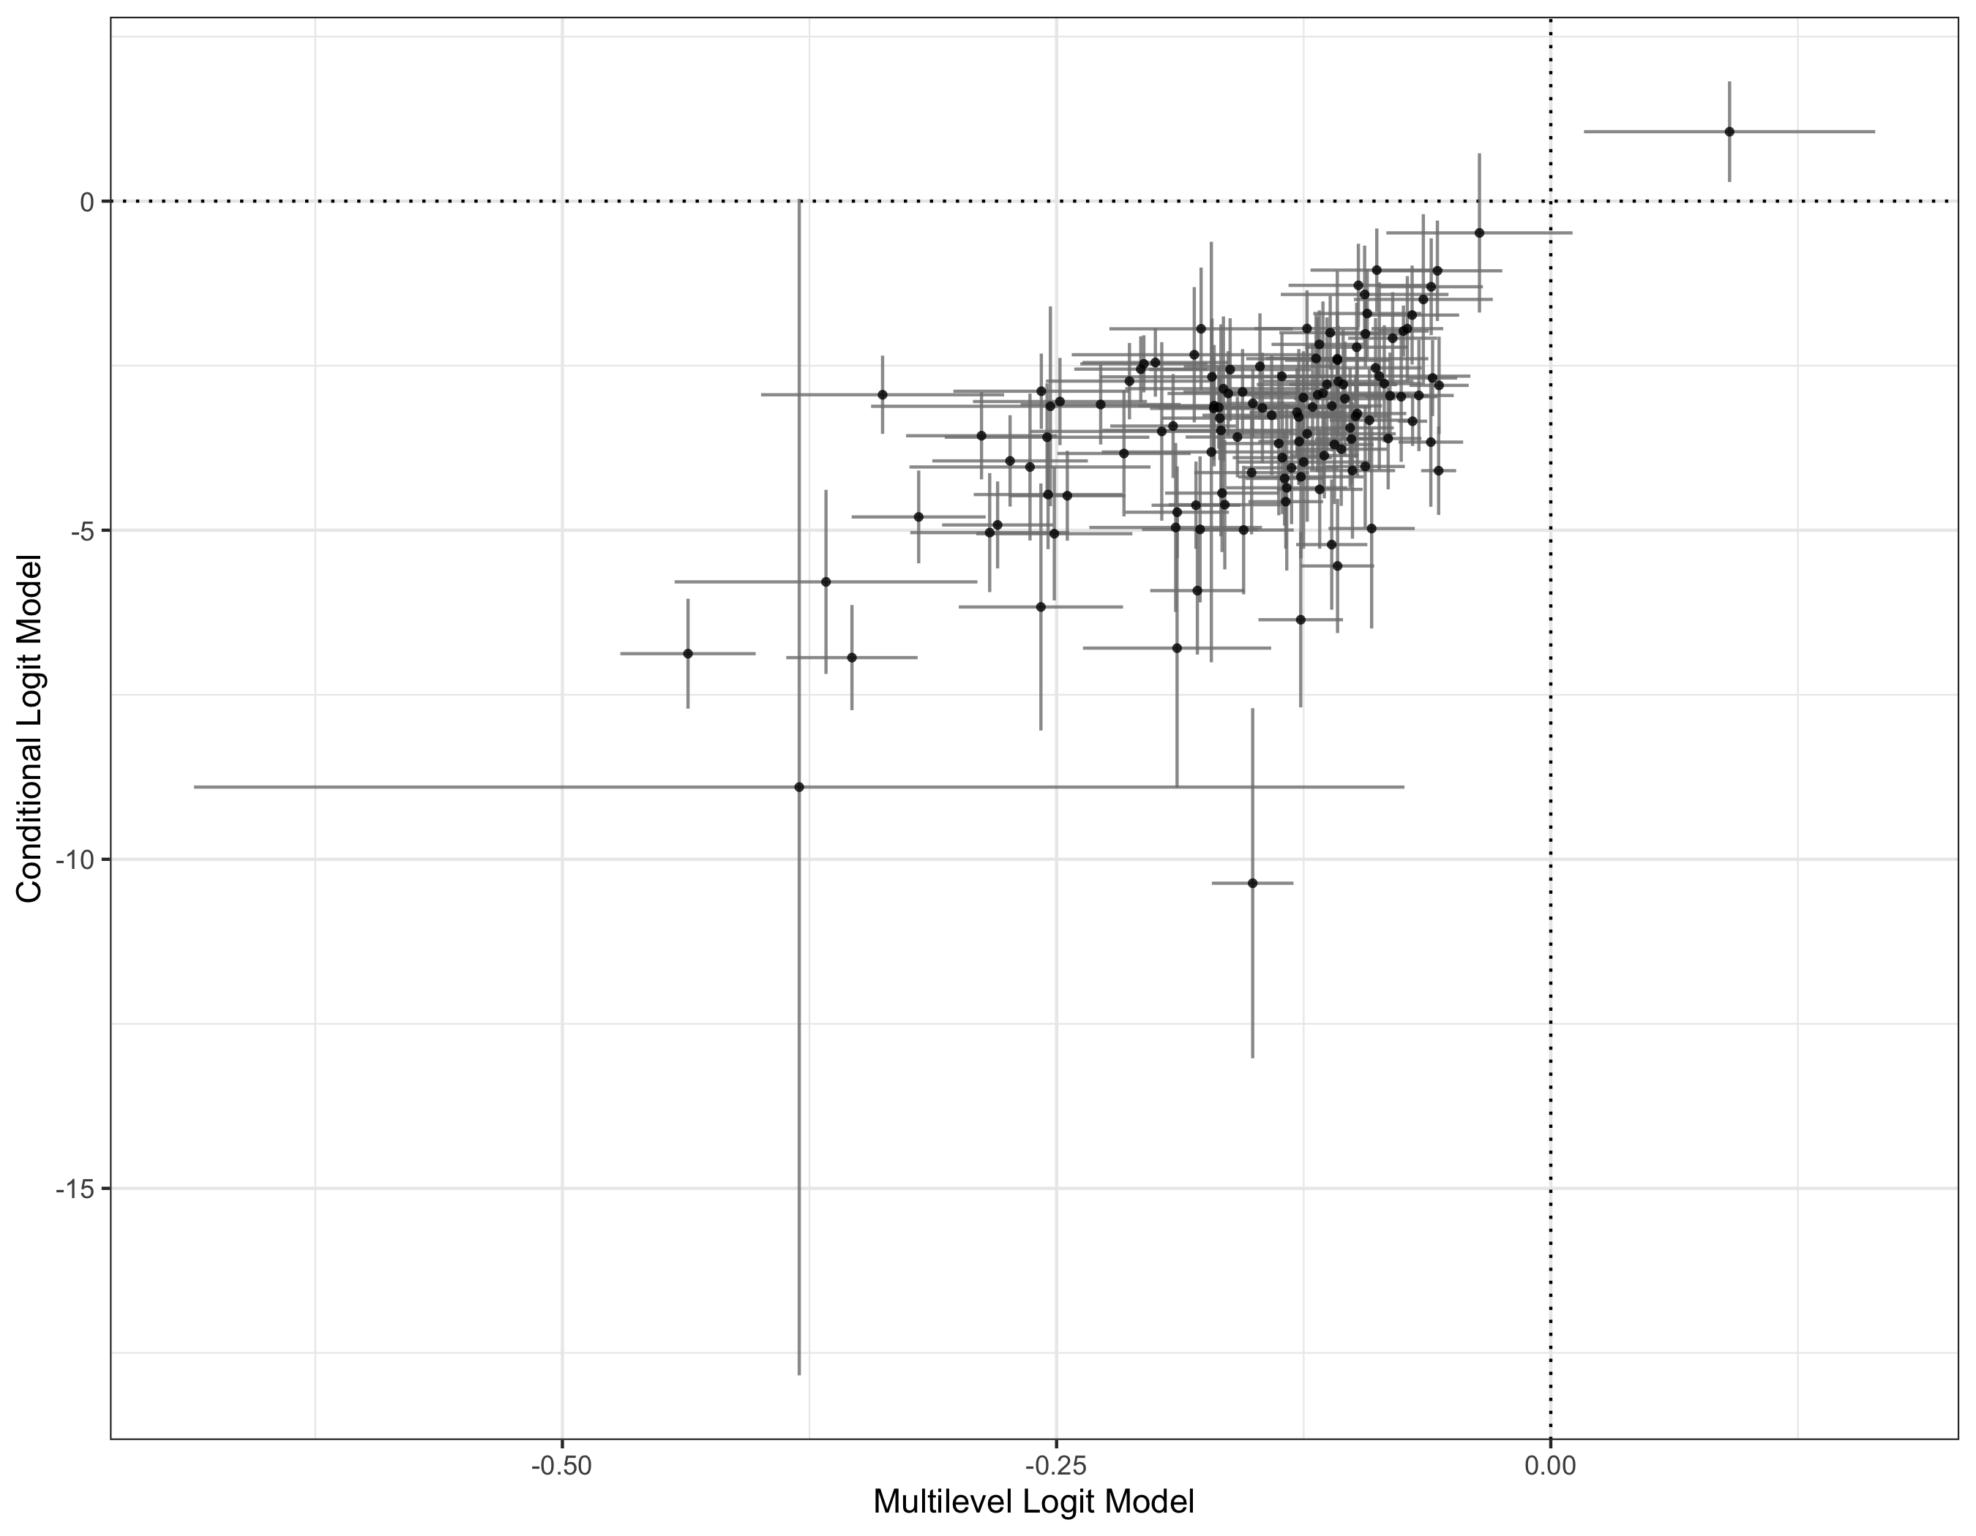
MBL vs CLM
Effect of left-right distance between voter and party

Slide 14
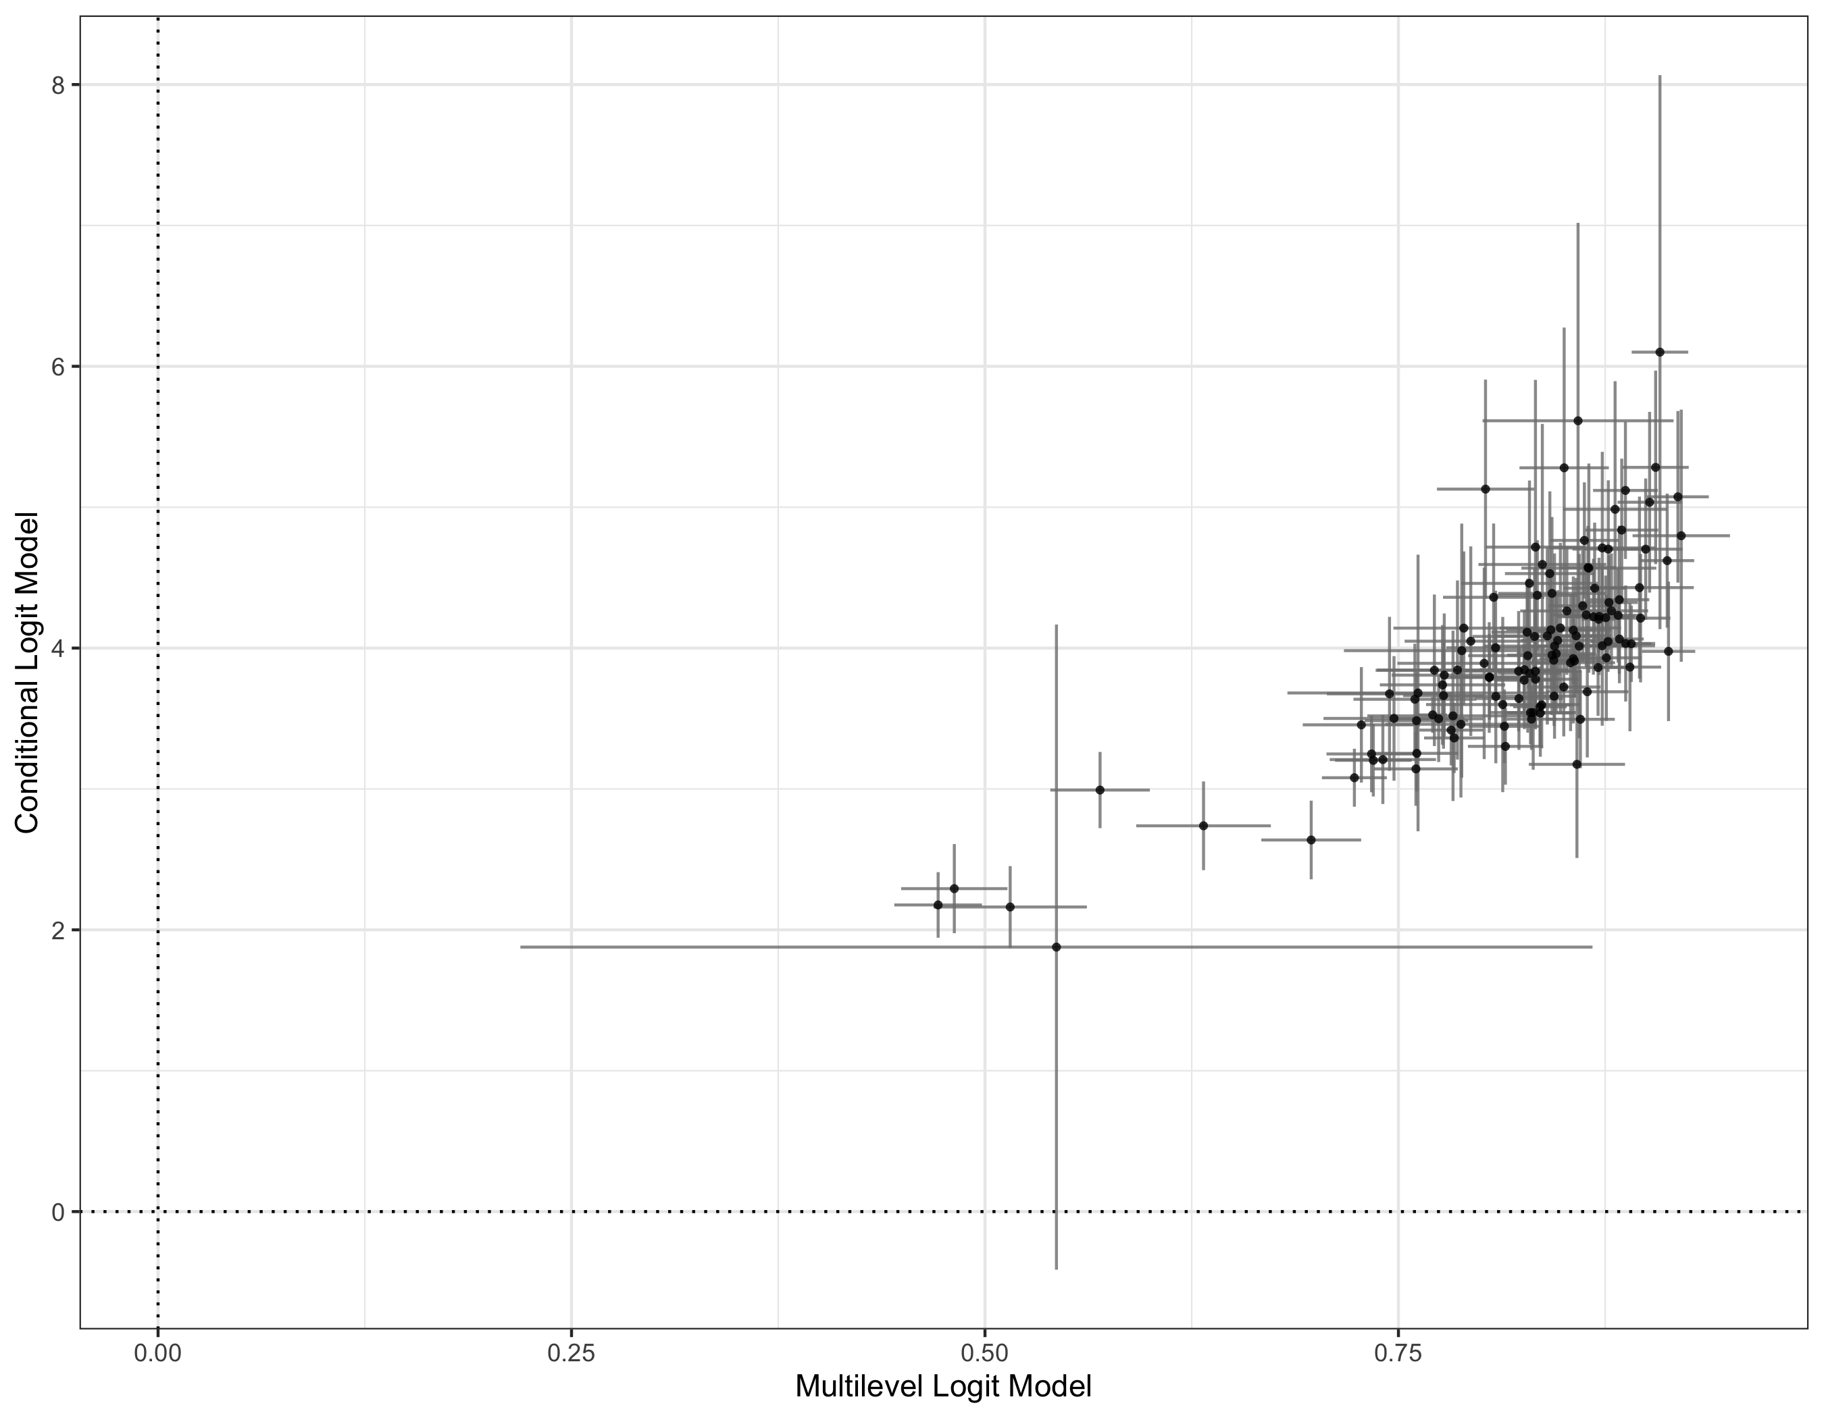
MBL vs CLM
Effect of party ID

Slide 15
How to include individual characteristics?
There exists a model, called mixed logit, which allows to include both characteristics of the voters and the parties
However, the same problem of MLMs applies: the alternatives change from election to election
Moreover, in this case we want generic effects: we do not care about the effect of being religious on voting for “party X”, but we want to see the effect of religion on the vote

Slide 16
Y-hats
A solution proposed by van der Eijk, Franklin & co., is to transform individual-level indicators in variables that change across choice options
How? In two steps
Regress the binary vote to every party with the set of individual characteristics
Use the individual predicted probability (or log-odd) as an indicator of “affinity” between the respondent and the party
The observed effect of this variable on the vote is interpreted as a generic effect of individual characteristics (e.g. religiosity, social class) on the vote

Slide 17
Y-hats
Y-hats present a number of issues, which are probably the most pressing issues with this method
Y-hats are estimates, and so they are produced by a model. When we include them in a model as predictors, we do not take into account the explanatory power of the model which produced them, nor the error associated with the estimate
Y-hats already include the dependent variable in them. So they obviously correlate positively with the DV, even if the effect of the variable that they capture is very small and not significant

Slide 18
Y-hats /2
Y-hats present a number of issues, which are probably the most pressing issues with this method
If y-hats are calculated including the intercept, they absorb the effect of the baseline probability to vote for a party, which is a function of a number of factors that are not explained by the predictors used to obtain them
For this reason, we usually center y-hats around the party average
If y-hats are based on predicted probabilities, they are not linear. This has implications for their variance: if a variable is bounded between 0 and 1, its variance is a function of the mean

Slide 19
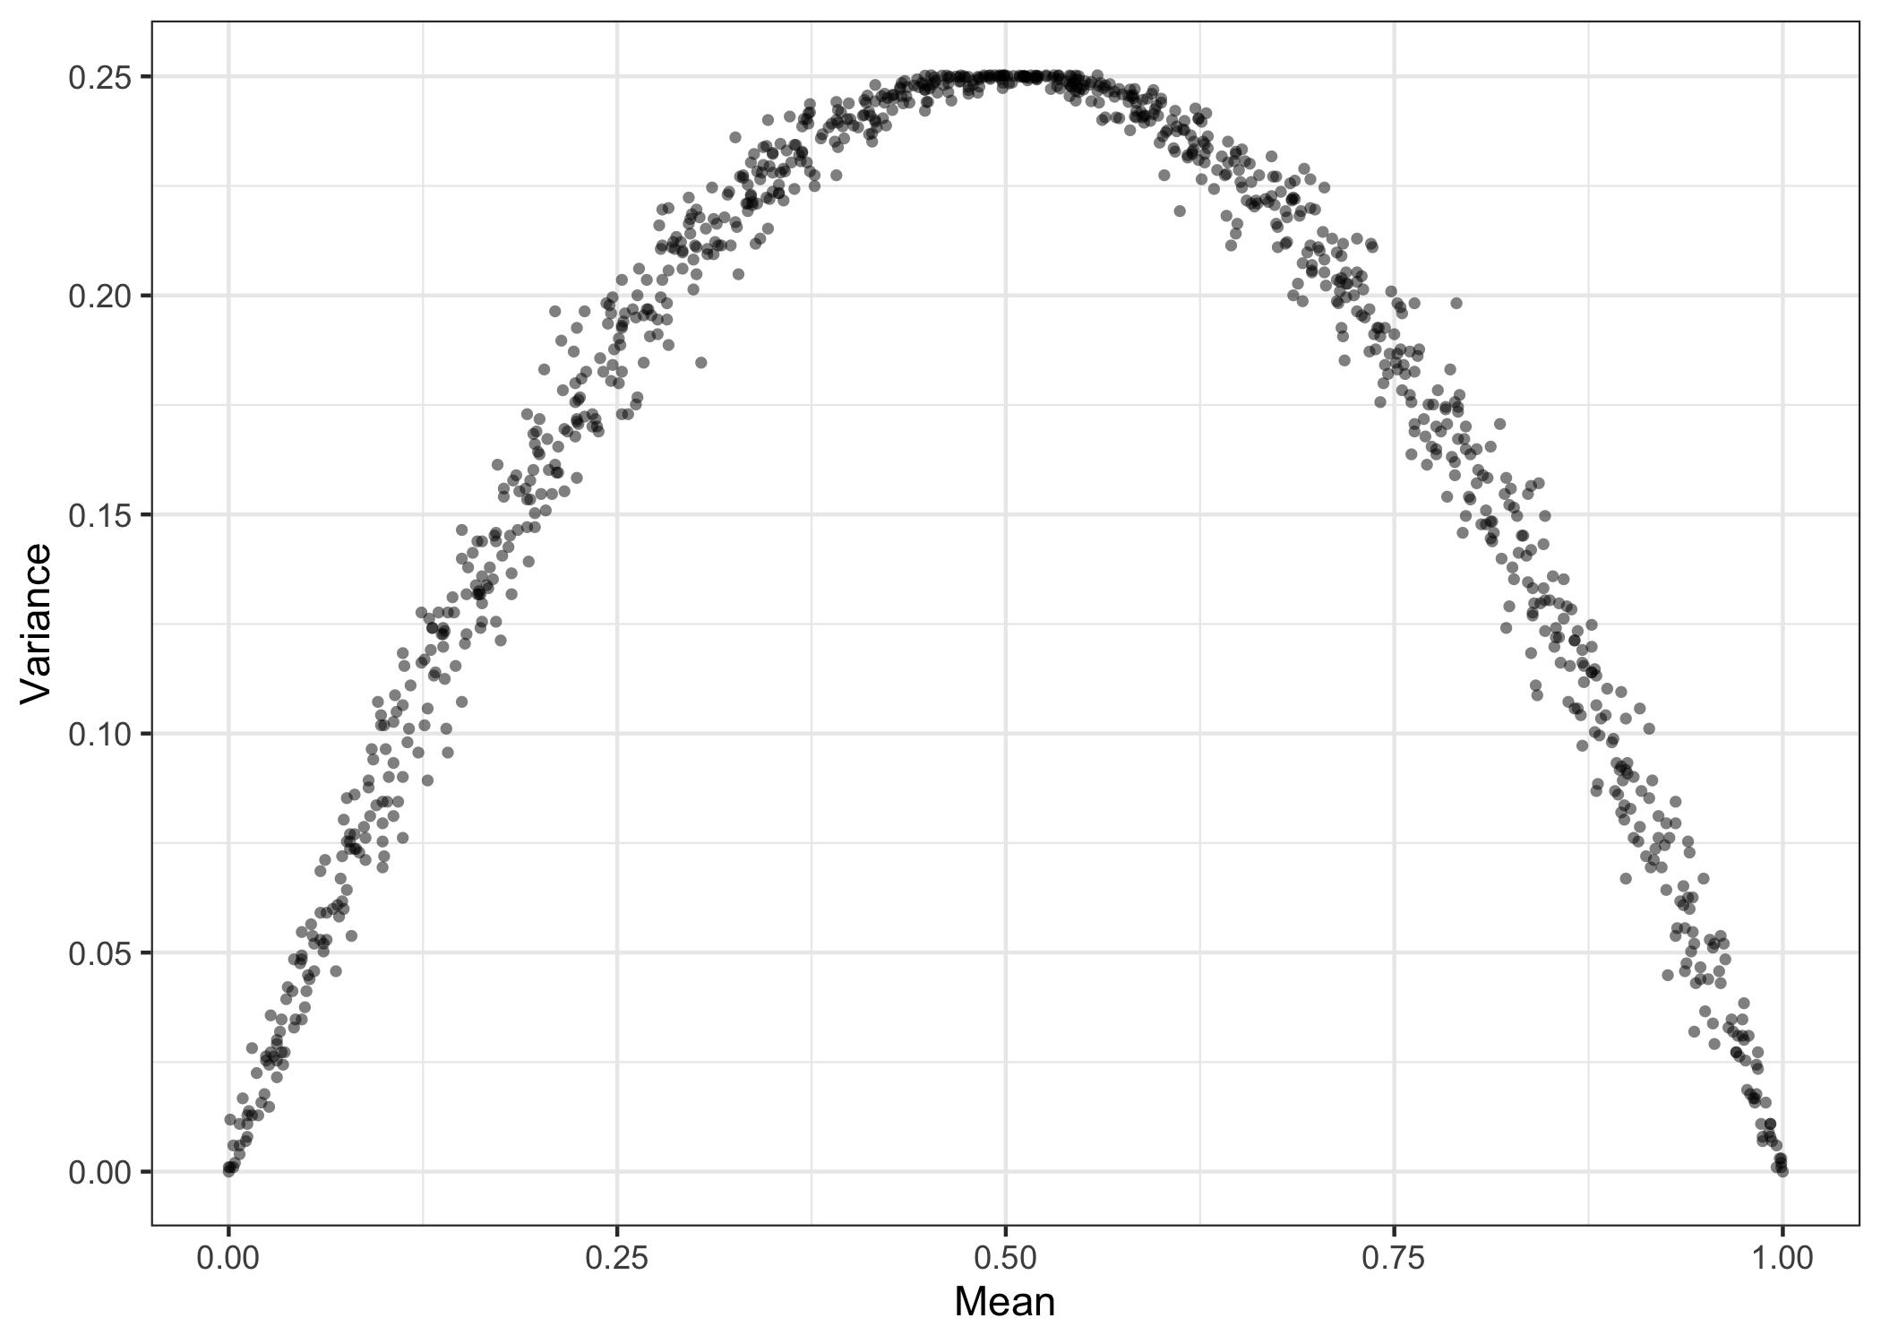
Mean vs. Variance in probabilities

Slide 20
Y-hats /3
The problem in point 4 implies that even if we center y-hats, we still have information about their mean captured by their variance
A way to sove this problem is to use values on the scale of the linear predictor (log-odds) instead of probabilities
How do we interpret the y-hats? Assuming we get it right with everything else, what does the value of the coefficient of a y-hat mean?
Most reviewers do not seem to like the y-hats (this is suggested by anecdotal evidence, i.e. talking to people submitting papers using y-hats over the years)

Slide 21
Some conclusions
The choice of the “correct” model is not a big deal:
MBL models with individual-party dyads nested within individuals are a well-established method, which does not bias systematically the results with respect of CLM
However, due to the lack of variation of the individual intercepts (which are also uninterpretable), the model might have troubles converging
Ideally, we would force the variance of the intercepts at 0 and keep the clustering of the errors
The only solution with the “y-hats issue” is to run a systematic study which tells, based on evidence (like simulations), when it is ok to use y-hats, and how to interpret them
Until then, we can also think of different ways to account for individual predictors (for instance, fit a MLM in every country and look how they vary as a function of country-level predictors)

